Slide 1
Glycosides

Slide 2
Topic Outline
General properties of glycosides
Classification of glycosides
Classes of glycosides:
  Anthraquinones glycosides
  Saponins glycosides
  Cardiac glycosides
  Simple phenolic glycosides
  Cyanogenetic glycosides
  Isothiocyanate glycosides

Slide 3
Glycosides
A glycoside is an organic compound, usually of plant origin, that is composed of a sugar portion linked to a non-sugar moiety.
The sugar portion is called glycone, while the non-sugar portion is called aglycone or genin.
Non-sugar molecule known as the aglycone and may be
  amino acid derivatives
  Steroids
  triterpenes
The linkage between the sugar and the aglycone is an acetal linkage.

Slide 4
1. Introduction
Glycosides are natural products composed of
  Sugar (glycone) parts and
  Non-sugar parts (aglycone or genin).

Slide 5
Why do we study glycosides?
A number of glycosides exist and some are medicinally useful.
Many glycosides are toxic
  Many are ecologically important.
  They could also serve as potential source of new drugs.
Some glycosides serve as starting materials for semi-synthetic drugs.

Slide 6
Glycosides
Glycosides consist of a sugar(glycone) residue covalently bound to a different structure called the aglycone.
The sugar residue is in its cyclic form and the point of attachment is the hydroxyl group of the hemiacetal function.
The sugar moiety can be joined to the aglycone in various ways:
Oxygen (O-glycoside)
Sulphur (S-glycoside)
Nitrogen (N-glycoside)
Carbon (C­glycoside)

Slide 7
Modern system of naming glycosides using the termination '-oside' (e.g. sennoside).
The term 'glycoside' is a very general one which embraces all the many and varied combinations of sugars and aglycones.
More precise terms are available to describe particular classes. Some of these terms refer to:
the sugar part of the molecule (e.g. glucoside).
the aglycone (e.g. anthraquinone).
the physical or pharmacological property (e.g. saponin “soap-like”, cardiac “having an action on the heart”).

Slide 8
According to the configuration of the glycosidic linkage
1- β-glycosides:
Here the sugar involved has the β configuration at the hemiacetal carbon.
The majority of plant glycosides isolated are β-glycosides.
2- α -glycosides: Here the sugar involved has the α configuration at the hemiacetal carbon; the sugar is usually of the L-series e.g. L-rhamnose. There are only few medicinal α-glycosides known, especially the rhamnosides.

Slide 9
Chemical Properties of glycosides
O-Glycosides can easily be cleaved into sugar and aglycone by hydrolysis with acids or enzymes. Most numerous kind found in nature
Glycosides represent a group of natural compounds of diverse chemical structures.
They only share the presence of one or more monosaccharide units in the structure.
However, the following general properties should be known:
1. Glycosides do not reduce Fehling's solution, but the sugars they produce after hydrolysis reduce Fehling's solution (ppt of red cuprous oxide).

Slide 10
2. Glycosides show no mutarotation except after hydrolysis (C-glycosides are exceptions).
3. Most glycosides are soluble in polar solvents such as
      water and alcohols
    They are generally insoluble in non-polar solvents while the aglycones are soluble in ether, chloroform and insoluble in water.
The presence of sugar increases the solubility of the glycoside in water, but depends on the number the sugar units.

Slide 11
Chemical Properties of glycosides
Most of the Glycosides are hydrolysable by boiling with acids
Almost all glycosides are accompanied by enzymes which can hydrolyze them.
The enzymes can be found in different part or cell of the plant or in the same cells being membrane bound.
During injury to the tissue, germination or other physiological activity, the enzymes may come in contact with the glycosides and the hydrolysis of the glycosides takes place.

Slide 12
Physical property
Most glycosides are crystalline compounds.
Glycosides are generally
  soluble in water, alcohol and hydroalcohols and
  less soluble in nonpolar organic solvents
The aglycone is
  insoluble in water and
  soluble in alcohol and other nonpolar organic solvents
The higher the sugar content, the less soluble are glycosides in organic solvent.
Glycosides form levorotatory solutions in water and alcohol.
Most glycosides have bitter taste.

Slide 13
Pharmacological properties of Glycosides
It is associates with the non-sugar moiety.
The sugar part influences the stability and ultimately pharmacokinetic property of the drug in the body.
Some glycosides are not active in their glycosidic form, but on hydrolysis they yield active aglycones. Such drugs are known as reactionary drugs.

Slide 14
Classification of Glycosides
1-According to the botanical origin of the producing plants.
Example:
  the glycosides of senna leaf are sennosides A, B, C ..etc.,
  those isolated from Digitalis purpurea leaves are purpurea glycosides A, B, C...etc. and
  salicin is obtained from Salix species.
2-According to the name of the glycones present in their structures.
For ex.
  Glucosides is a term given to the glycosides having glucose as the sugar part, i.e. rhamnosides when the sugar is rhamnose or galactosides when the sugar is galactose and so on.

Slide 15
Glycosidal Sugars
  Sugars found in glycosides may be
  Monosaccharides
    Glucose
    Rhamnose
    Fructose
  Deoxysugars (more rare)
    Cymarose
  E.g. those found in the cardiac glycosides
Some sugars found in cardiac glycosides

Slide 16
3-Depending on the number of sugar units attached to the aglycone, glycosides may also be termed
  Monosides
  Biosides
  triosides... etc.
4-According to their pharmacological activities, glycosides can be named as
cardiac glycosides
anti-inflammatory
anti-rheumatic glycosides
renal disinfectants
Analgesics
laxative glycosides
counter irritant etc
5- According to the type of the glycosidic linkage is also used to classify the glycosides into two major groups either β-glycosides or α-glycosides.

Slide 17
6-According to the functional group of the aglycone involved in the glycosidic linkage. i.e , there are
  O-Glycosides: most of the glycosides are formed by combination of a sugar(s) with the alcoholic or phenolic -OH group of a second compound (aglycone). E.g., Senna, rhubarb etc.
  S-Glycosides: when the linkage involves a sulfur atom of the aglycone which confirms - (thiol, SH group). E.g., Sinigrin from black mustard
Glycone - OH + H O – aglycone Glycone – O – aglycone + H₂O
Glycone - OH + H S – aglycone Glycone – S – aglycone + H₂O

Slide 18
  N-Glycosides: when the aglycone (containing -NH group) is linked to the sugar through the N atom.
  C-Glycosides: where the glycosidic linkage involves a covalent bond between the sugar and the aglycone, it is a rare type of glycosides. This class of glycosides resists the usual hydrolysis procedures. E.g., Aloe
Glycone - OH + H N – aglycone Glycone – N – aglycone + H₂O
Glycone - OH + H C – aglycone Glycone – C – aglycone + H₂O

Slide 19
7-According to the chemical structure of the aglycone.
  Anthraquinone glycosides
  Saponin Glycosides
  Sterol or Cardiac glycosides
  Simple alcoholic and phenolic glycosides.
  Flavonoid Glycosides
  Isothiocyanate Glycosides
  Cyanogenetic glycosides.
  Coumarin glycosides.
  Alkaloidal glycosides or glyco-alkaloids
  Antibiotic Glycosides.
  Complex glycosides (tannins, polysaccharides, derived).

Slide 20
1. Anthracene glycosides
A number of glycosides in which the aglycones are anthracene derivatives occur as the pharmacologically active constituents of several cathartics of plant origin; e.g. cascara, rhubarb, aloe and senna.
These anthracene glycosides are sometimes referred to as the anthraquinone glycosides or the anthraglycosides.

Slide 21
Interrelationship of anthraquinone derivatives

Slide 22
Glycosides:
  O-glycosides:
  e.g. Cascarosides A & B. They are both O- and C-glycosides. Each one contain two sugar units.
  C-glycosides:
  e.g. Barbaloin is formed by the removal of one sugar from Cascarosides.

Slide 23
CHEMICAL CONSTITUENTS
Sennosides A&B
Sennosides C&D

Slide 24
CRUDE DRUGS CONTAINING
ANTHRAQUINONE GLYCOSIDES
Senna
Senna pods
Aloes
Rhubarb
Cascara

Slide 25
Senna
Synonyms: (senna folium, senna-ki-patti, tinnevelly senna cassia senna)
Biological source: It consists of the dried leaflets of Cassia senna (Alexandrian senna), or Cassia angustifolia (Tinnevelly senna).
Family: LEGUMINOSAE.
Geographical source:
  Indigenous to Africa (tropical regions). Used since 9th – 10th century
  Introduced into medicine by Arab physicians (used both the leaves and pods)
  Exported by Alexandria – name of the Sudanese drug.

Slide 26
Comparison of Macroscopical characters
INDIAN SENNA | ALEXANDRIAN SENNA
YELLOWISH-GREEN | PALE-GREYISH GREEN
7-8mm width and25 -60mm length | 2-4cm long and 7-12mm wide
broken and normally flat | Broken and curled at edges
Often shows impressions | Few press markings
Comparison of Chemical test
Ether extract of hydrolysed acid solution of herb with methanolic magnesium acetate solution gives
Pink colour in daylight | Orange colour in daylight
Pale green-orange colour in filtered UV light | Yellow-green colour in filtered UV light

Slide 27
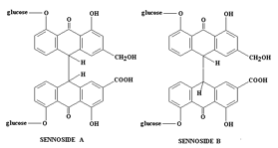
Chemical Constituents
2 active glycosides: Sennoside A
Sennoside B
  Both hydrolyse: 2 molecules glucose + aglycones: Sennidin A and Sennidin B.
Sennoside C & Sennoside D
Kaempferol (yellow flavanol)+ glucoside (kaempferin)
Rhein
Aloe-emodin
Palmidin A (Rhubarb)
Mucilage
Calcium oxalates
Resin

Slide 28
ADULTERANTS
Tinnevelly senna and alexandrian senna are adulterated with
  DOG SENNA (papillose cells in lower epidermis)
  PALTHE SENNA (No Anthraquinone glycosides)
  MECCA and ARABIANSENNA (brown-green colour, elongated)

Slide 29
Cascara Bark
Synonyms: (Cascara sagrada ,Sacred bark, Chittem bark, Cortex Rhamnipurshianae)
Biological source: Dried bark of Rhamnus purshiana De candolle of
Family: Rhamnaceae.
Collection: It is collected in between april-august when it is readily separates from wood.
By longitudinal incision of 5-10cm.
MACROSCOPY:
Colour - Externally purplish brown and
Internally reddish brown
Odour - Nauseous
Taste - Bitter
Size - 1-4mm thickness.
Broken pieces small and flat occurs as quills/channels.
Internally longitudinal striations.

Slide 30
Storage
  During preparation and storage the bark should be protected from rain and damp (partial extraction of constituents may occur or bark may become mouldy).
  Should be stored for at least 1 year before use (although no longer a BP requirement).
  Bark appears to increase its medicinal value upto 4 years old (stored bark)
Why Stored for a Year?
  When stored for at least a year – better tolerated by patient (less griping pains due to increased peristalsis)
  Yet as effective as fresh bark.
Reason?
  Due to Hydrolysis and other changes that occur during storage.
  Bitter taste of Cascara can also be reduced by treating the bark with alkali (alkali earths or MgO).

Slide 31
Chemical Constituents
4 main glycosides – Cascarosides A-D
  Cascaroside A
  Cascaroside B
  Cascaroside C
  Cascaroside D
2 aloins:
  The C-linked glucose at C-10 protect anthrones from oxidation.
  Breakdown products of Cascarosides A-D
    Barbaloin present as a secondary glycoside in Cascara (derived from aloe-emodin)
    Chrysaloin (derived from chrysopanol anthrone)

Slide 32
Constituents
O-glycosides
Derived from
  Emodin
  Emodin oxanthrone
  Aloe emodin
  Chrysophanol
Dianthrones
  Those from
  Emodin
  Aloe-emodin
  Chrysophanol
  Hetrodianthrones
    Palmidin A, B and C (Rhubarb)

Slide 33
Substitutes
  Rhamnus alnifolia (too rare)
  Rhamnus crocea (bark is very different from official drug)
  Rhamnus californica (so closely related to Rhamnus purshianus some botanists do not consider them to be separate species).
  Rhamnus fallax
Uses
  Purgative
  Similar to Senna
  Normally as a tablet
  Also used on animals

Slide 34
ALOES
Synonyms: ALOE, MUSSABBAR, KUMARI
Biological source:
Dried juice of leaves of
Aloe ferox Miller,
Aloe barbadensis Miller (curacao aloes),
Aloe perryi Baker (socotrine aloes),
Aloe africana Miller and
Aloe spicata Baker (cape aloes)
Family: Liliaceae.
Cultivation and collection:
Cultivated by root suckers.
No water logging.
Juice is collected by a cut at leaf base.

Slide 35
Preparation of Cape Aloes
Curacao aloes: Place the leaves in kerosene tins and kept in tilted position to drain out all the juice and boil on large copper pans and pour in metal containers.
Cape Aloes :
  They are placed in ground in basin shaped depression which is lined by goat skin /canvas for 5-6 hrs.
  Cape Aloes are prepared from the wild plants of Aloe ferox.
  Leaves are cut transversely near the base.
  200 leaves arranged around a shallow hole in the ground (lined with canvas or goatskin).
  Cut ends overlap & drain into the canvas.
  After 6hrs all the juice is collected.
  Transferred to a drum.
  Boiled for 4hrs on an open fire.
  Poured into tins while hot → solidifies.
Socotrine and Zanzibar Aloes: juice is collected in goat skin and solidified.

Slide 36
MACROSCOPIC CHARACTERS
CURACAO | CAPE | SOCOTRINE | ZANZIBAR
STRONG ODOUR | NAUSEOUS | NAUSEOUS | -
BROWNISH-BLACK yellow-brown – chocolate brown | BROWNISH-GREEN | BROWNISH-YELLLOW | LIVER BROWN
OPAQUE MASS | MASSES | OPAQUE PASTY MASS | -
BITTER TASTE | BITTER TASTE | BITTER TASTE | BITTER TASTE
UNEVEN FRACTURED | GLASSY FRACTURED | CONCHOIDAL | EVEN FRACTURED

Slide 37
Chemical Constituents :
  C-glycosides
  Resins
  The major glycoside in Aloes is the C-glycoside Aloin
    Barbaloin
    Isobarbaloin
  Aloe-emodin
Cape Aloes: Also Contain
Aloinoside A & Aloinoside B (O-glycosides of barbaloin)
  The C-linked glucose at C-10 protect anthrones from oxidation.
Uses
Purgative
Activity is increased when administered with small quantities of soap or alkaline salts; Carminatives moderate griping tendency.

Slide 38
Chemical Tests
Unlike C-glycosides, O-glycosides of Aloe are not hydrolysed by heating with dilute acids or alkali.
Can be decomposed with ferric chloride & dilute HLC - Modified Borntrager’s Test – oxidative hydrolysis. Anthraquinones give a red colour when shaken with dilute ammonia.
All Aloes give a strong green fluorescence with borax (characteristic of anthranols) - General test for aloes.

Slide 39
Substituents & Adulterants
Socotrine, zanzibar, Natal aloes ,Mocha aloes with BLACK CATECHU.
Natal: Dry extract of aloe candelabra for cape aloes.
Mocha: Brownish black glossy fragments interior varieties.
Curacao aloes with BLACK CATECHU , IRON, STONES.
These are derived from the mucilage gel – parenchyma cells
Should not be confused with aloes (juice of pericycle – juice used for laxative effect).
Cosmetic industry (usefulness often exaggerated) - Used as suntan lotions, tonics and food additives.
Mucilage = polysaccharide of glucomannans and pectin

Slide 40
RHUBARB
Synonyms: Radix rheum, Revandchini, Rheum
Biological source :Dried rhizomes of Rheum emodi Wallich,
Rheum palmatum Linn ,
Rheum webbianum Royle
Family: polygonaceae
Collection and preparation:
  Drug obtained from wild plants which are draught resistant.
  Propagated by seeds, rhizomes.
  Harvested in spring season and the rhizomes are collected and cleaned & de-corticated, dried and packed in wooden boxes.

Slide 41
Chemical Constituents
Anthraquinones without a carboxyl group – chrysophanol, emodin, aloe-emodin & physcion.
Also the glycosides of these substances.
2. Anthraquinones with a carboxyl group (rhein and its glycoside: glucorhein).
Anthrones and dianthrones of chrysophanol, emodin, aloe-emodin or physcoin.
4. Dianthrone glucosides of rhein (Sennosides A and B).
Hetrodianthrones derived from 2 different anthrone molecules: Palmidin A and Palmidin B.
Free anthraquinones: chrysophanol, emodin, aloe-
emodin and rhein.
7. Some of the above constituents may also occur as
glycosides.

Slide 42
Uses
Bitter stomachic
Diarrhoea (low doses) – contains tannins
Purgative (high doses) – followed by an astringent effect.
Suitable only for occasional for occasional use, not for chronic constipation.
    It is purgative only in large doses.
    It contains high amount of tannins that have astringent effect.

Slide 43
Mechanism of Action
The glycosides are absorbed from the small intestine and re-excreted in the large intestine where they increase the motility so produce laxation.
Aglycones produce griping effect so it is recommended to prescribe antispasmodic with them.

Slide 44
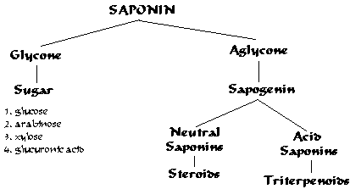
2. Saponin glycosides

Slide 45
A group of plant glycosides known as saponins share in varying degrees, two common characteristics:
(a) They foam in aqueous solution.
(b)They are generally considered as haemotoxic, because they cause haemolysis of red blood cells(erythrocytes). Due to this activity some of them are used as fish poisons.
The actual cause of the haemolysis:
The red blood cells carry sterols in their membranes, and when brought into contact with saponins, the sterols of the RBCs are precipitated and the colloidal chemical properties of the membrane are so altered as to give hemoglobin passage to the surrounding medium.

Slide 46
The aglycones of the saponins are collectively referred to as Sapogenins.
The more poisonous saponins are often called Sapotoxins.
Plant materials containing saponins have long been used in many parts of the world for their detergent properties for example,
  In Europe, the root of Saponaria officinalis (Fam. Caryophyllaceae) and
  In South America, the bark of Quillaia saponaria (Fam. Rosaceae).
Such plants contain a high percentage of the glycosides known as saponins (Latin Sapo, means Soap) which are characterized by their property of producing a frothing aqueous solution.

Slide 47
Properties:
Saponins form colloidal solution in water (hydrophilic colloids) which froths upon shaking.
They cause irritation of mucous membrane.
These substances modify and lower the surface tension and therefore foam when shaken.
Use to increase the foaming of beer.
Industrial applications of saponins include their use in cleaning industrial equipment and fine fabrics
As powerful emulsifiers of certain resins, fats and fixed oils.

Slide 48
Structure of Saponins:
According to the structure of the aglycone or sapogenin, two kinds of saponin are recognized:
The steroidal type (commonly tetracyclic triterpenoids, C-27).
The triterpenoid type (pentacyclic triterpenoids, C-30).
Both of these have a glycosidal linkage at C-3 and have a common biosynthetic origin via mevalonic acid and isoprene units.

Slide 50
Some examples of saponins
  Dioscorea
  Liquorice
  Shatavari
  Ginseng
  Senega
  Quillaia
  Gokhru

Slide 51
A. Steroidal saponins
The steroidal saponins are less widely distributed in nature than the pentacyclic triterpenoid type.
Steroidal saponins are of great pharmaceutical importance because of their relationship to compounds such as the sex hormones, cortisone, diuretic steroids, vitamin D and the cardiac glycosides.
Examples: Diosgenin (Dioscorea sylvatica), Sarsapogenin (Smilax sp.).

Slide 52
Dioscorea
Synonyms: Yam, rheumatism root
Biological source: It consists of dried tubers of the plants Dioscorea deltoidea
Family: Dioscoreaceae
Macroscopic characters:
Colour - Slightly brown
Odour - Odourless
Taste - Bitter

Slide 53
Chemical constituents:
  Dioscorea rhizomes contain diosgenin a steroidal saponin(4 to 6%).
  Starch 75%
  Enzyme sapogenase
Uses:
  The rhizomes are used as rich source of diosgenin.
  It is used as a precursor for synthesis of several corticosteroids, sex-hormones and oral contraceptives.
  Used in treatment of rheumatoid arthritis.

Slide 54
B. Pentacyclic triterpenoid saponins
Triterpenoid saponins my be classified into three groups represented by α-amyrin, β-amyrin and lupeol.
Examples: Primulagenin (Primula sp.), Quillaiac acid (Quillaia saponaria) and Glycyrrhetinic acid (Glycyrrhiza sp.).

Slide 55
Liquorice
Synonyms: Liquorice root, glycyrrhiza
Biological source:
  It consists of dried, peeled and unpeeled root and stolon of Glycyrrhiza glabra Linn.
Family: Leguminosae
Macroscopy:
  Colour - Unpeeled yellowish brown Peeled is pale yellow in colour
  Odour - Faint and characteristic
  Taste - Sweet
  Shape - Cylindrical pieces

Slide 56
Chemical constituents:
  The Chief active constituents of liquorice is triteropenoid saponin known as glycyrrhizin(glycyrrhizic acid), which is a potassium and calcium salt of glycyrrhizinic acid.
  Glycyrrhizinic acid is glycoside and on hydrolysis yields glycyrrhetinic acid(glycyrrhetic acid), which has a titerpenoid structure.
  Glycyrrhizinic acid is 50 times sweeter than sugar (sucrose).
  Upon hydrolysis, the glycoside loses its sweet taste and is converted to the aglycone glycyrrhetinic acid plus two molecules of glucuronic acid.
  Flavonoids (liquiritin and isoliquiritin)

Slide 57
Uses:
  Traditionally it is used as an expectorant and demulcent.
  It is used in cough mixtures, and as a flavouring agent in formulations with nauseous drugs.
  Flavonoids are used in peptic ulcer in the form of deglycyrrhized liquorice.
  It is also used as antispasmodic(due to flavonoid isoliquiritin).
  As a flavouring agent for chewing tobacco and snuff tobacco.

Slide 58
3. Cardiac glycosides
Cardiac glycosides are a group of natural products characterized by their specific effect on myocardial contraction and atrioventricular conduction.
In large doses they are toxic and bring about cardiac arrest in systole, but in lower doses they are important drugs in the treatment of congestive heart failure.
They have a diuretic activity. Since, the improved circulation tends to improve renal secretion, which relieves the edema often associated with heart failure.

Slide 59
✓ Distribution in nature
Cardiac glycosides occur in small amounts in the seeds, leaves, stems, roots or barks of plants of wide geographical distribution, particularly of the family
  Apocyanaceae
    e.g. seeds of Strophanthus, roots of Apocynum and fruits of Acokanthera);
  Scrophulariaceae
    e.g. leaves of Digitalis sp.,
  Liliaceae
    e.g. scales of the bulbs of Urginea and Convallaria, and
  Ranunculaceae
Cardiac glycosides are also found in animals only in exceptional cases: Bufadienolides occur in toads (Bufo).

Slide 60
Structure of cardiac glycosides
The structure comprise a steroidal aglycone of the (C₂₃) cardenolide type or of the (C₂₄) bufadienolide type, and a sugar moiety, most often an oligosaccharide.

Slide 61
A. Structure of the aglycones
All of the aglycones have in common the classic, tetracyclic, steroidal nucleus.
The A, B, C and D rings normally have a cis-trans-cis configuration or less often, a trans-trans-cis configuration.
Also common to all the aglycones is the presence of two hydroxyl groups: one is a 3β secondary alcohol, the other is a 14β tertiary alcohol.
All of the aglycones have a β constituent at C-17: an α,β-unsaturated lactone.

Slide 62
The size of the lactone ring distinguishes two groups of aglycones: the C₂₃ cardenolides with an α,β-unsaturated γ-lactone (= butenolide) and the C₂₄ bufadienolides with a di-unsaturated δ-lactone (= pentadienolide).

Slide 63
B. Structure of the sugar moiety
The sugar moiety is generally linked to the aglycone through the hydroxyl group at C-3.
The majority of the saccharides found in cardiac glycosides are highly specific:
2,6-dideoxyhexoses, e.g. D-digitoxose
2,6-dideoxy-3-methylhexoses, e.g. D-diginose
6-deoxyhexoses, e.g. L-rhamnose
6-deoxy-3-methylhexoses, e.g. D-digitalose
Hexose, e.g. glucose (when these is a glucose unit, it is always terminal).
The sugars can modify the activity (potency, toxicity), the solubility, the diffusion through membranes, the rate of absorption and transportation of the glycosides.

Slide 66
 Biosynthetic origin
Aglycone of the cardiac glycosides are derived from mevalonic acid but the final molecules arise from a condensation of a C₂₁ steroid with a C₂ unit (the source of C₂₂ and C₂₃).
Bufadienolides are condensation products of a C₂₁ steroid and a C₃ unit.

Slide 67
Pharmacological properties
Cardiac glycosides increase the force and speed of contraction of the heart. In patients with cardiac insufficiency, this positive inotropic effect translates into
  an increase in cardiac output.
  an increase in cardiac work capacity without any increase in oxygen consumption.
  a decrease in heart rate, and, indirectly.
  a decrease in arterial resistance.

Slide 68
Pharmacological Action of Cardiac Glycosides
Effectiveness depends on both the aglycones and the sugar attachments.
Medicinal action depends on the aglycone
But the sugars make the compound more soluble in increases the fixation of the glycoside to the heart muscle.
It is thought to act in competition with K ions for specific receptor enzymes (ATPase) sites in the cell membranes of the heart muscle when there is an influx of Na ions.
Effect is to increase the force of heart contraction
Diuretic action relates to the improved circulatory effects.

Slide 69
Cardiac glycosides
Influence of sugar units on absorption, on set of action and half-life of cardiac glycosides
Number of sugars | Water solubility | Route of administration | On set of action | Elimination
Less | Less | Oral | Slow | Slow
More | More | Parentral (IV) | Very fast | Fast

Slide 70
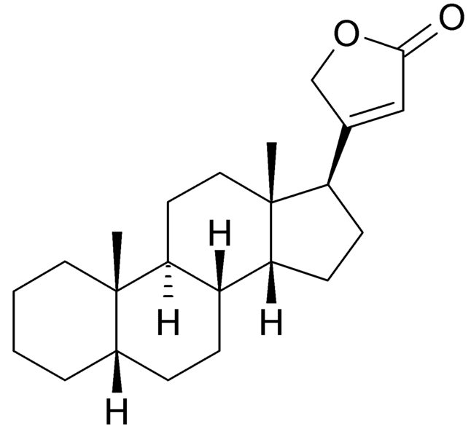
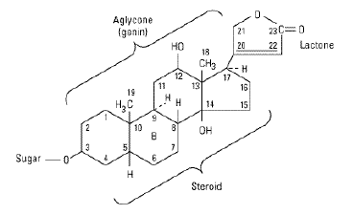
Cardenolide

Slide 71
Digitalis glycosides
Several species of Digitalis yield pharmacologically active principles. The most important of these species are Digitalis purpurea and Digitalis lanata.
Digitalis purpurea folium (Red foxglove leaves)
0.15% − 0.4% total cardenolides, ∼ 30 glycosides Purpurea glycosides A and B (∼60%), digitoxin (∼12%), gitoxin (∼10%) and gitaloxin (∼10%).
Digitalis lanata folium (White foxglove leaves)
0.5% − 1.5% total cardenolides, ∼ 60 glycosides Lanatosides A and C (∼50%), lanatosides B, D, E as well as digoxin and digitoxin.

Slide 72
Digitalis (Purple Foxglove)
Biological Source:
  Digitalis consists of the dried leaves of Digitalis purpurea.
Family: Scrophulariaceae
Habitat:
  Native to Western Europe. Although the plant is cultivated, wild plants are thought to be superior.
History:
  The poisonous nature of the leaves are well known, and the drug was recommended for use since 1542.
Discovered by William Withering, an 18th century country doctor (cardiac effect)
His work led to the production of a life-saving medicine

Slide 73
It is generally agreed that the first-year leaves collected in Jan-Feb (Southern Hemisphere) have the highest content of total glycosides. After that they decrease during the winter months. After that another peak is reached during the time of flowering, but not as high as the first one.

Slide 74
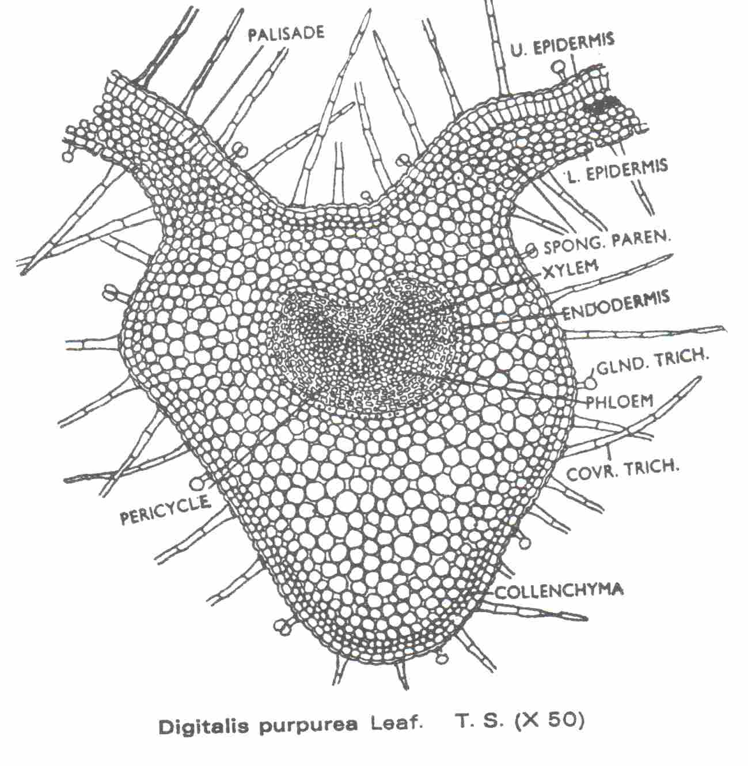
Microscopical Characteristics
Stomata and hairs present on both surfaces (more on lower surface)
No calcium oxalate
Clothing hairs are uniseriate
Glandular hairs

Slide 75
Active Constituents
Glycosides
  purpurea glycoside A
  purpurea glycoside B
(2 main actives in the fresh leaf)
  Glucogitaloxin
At C-3 of the genin: a linear chain of 3 digitoxose sugar moieties terminated by glucoseOn drying: enzyme degradation takes place → loss of the terminal glucose. Produces
  Digitoxin
  Gitoxin
  Gitaloxin
(main actives in dried leaves)
Poor storage leads to further hydrolysis and complete loss of action

Slide 76
Digitalis – Active Constituents
also contains anthraquinone glycosides
Saponins
Sopogenins
Flavonoids
Other glycosides
(present in smaller
quantities)
  Digitalose
  Glucose
  Verdoxin
  (x3 more toxic than gitaloxin)

Slide 77
Digitalis – Medicinal Actions
Tonic effect on the diseased heart
Glycosides enable the heart to beat more strongly, slowly and regularly, without using or needing more O₂.
Stimulates urine production → lessening the load on the heart.
Other uses of the plant (and glycoside) include being used as arrow poisonings.
Cautions
Potential for overdose
Only under professional supervision
Plant is subject to legal restrictions.

Slide 78
Digitalis contain three major aglycones

Slide 79
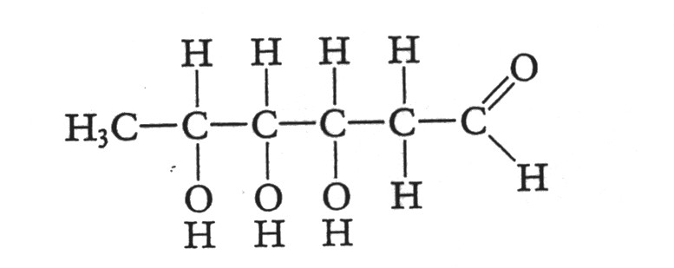
Sugars in digitoxin
2 molecules of digitose
1 molecule of 1-acetyl digitose
1 molecule of glucose
Digitose

Slide 80
Strophanthus
Biological source:
  It consists of dried seeds (ripe) of the plant Strophanthus kombe
Family: Apocynaceae
Habitat: East Africa.
Greek strophos
(a twisted cord or rope) anthos (a flower)

Slide 81
Chemical constituents:
  Strophanthoside
  strophanthin
  Cymarin
  all based on genin – strophanthidin)
  Alkaloid: Inoeine
  Fixed oil, resin
  Mucilage
Uses - similar to Digitalis
  Chronic cardiac weakness
  Can be administered IV
  Poisonous
  Diuretic action
  (thought to be more
  Powerful than Digitalis)

Slide 83
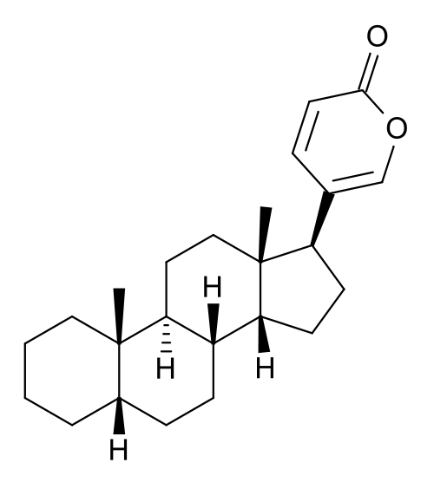
Bufadienolide

Slide 84
Bufadienolides
Less commonly distributed in nature than cardenolides
Occur in some Liliaceae and Ranunculaceae Species. Also occur in toad venoms.
Therapeutically there is not much value as the therapeutic index is low and production of side effects high.
Squill, however has a time-honoured place as an expectorant
Widely used in the treatment of cough.

Slide 85
Squill
Biological source :
  Consists of the dried sliced bulbs of Urginea maritime, from which the membranous outer scales have been removed.
  It is commercially known as white squill.
Family: Liliaceae
History: Squill appears in Egyptian Ebers papyrus (1500BC)
In Greece it was used by Pythagoras & Hippocrates in the 6th & 5th centuries BC.
Description:
  A perennial herb growing up to 1.5 m from a large white (or red) bulb.
  It has a single flowering stem, a rosette of large basal leaves, and a dense spike of white flowers.

Slide 86
Squill glycosides
Urginea maritima (L.)
0.1% − 2.4% total bufadienolides, ∼15 glycosides
White variety: average 0.2%-0.4%
proscillaridin A, scillaren A, glucoscillaren A (aglycone: scillarenin)
scilliphaeoside, scilliglaucoside
Red variety: < 0.1%
scilliroside and glucoscilliroside (aglycone: scillirosidin); proscillaridin A and scillaren A as in the white variety

Slide 87
Actions & Uses
glycosides are poorly absorbed in GIT → short action duration (not cumulative)
In small doses: mild gastric irritation causing a reflex secretion of bronchioles
Reflex expectorant action
Larger doses: emetic
Diuretic
Cardiotonic
Cautions:
Only under professional supervision.
Toxic in excessive doses
Unofficial varieties
Red Squill – contains squilloriside – very toxic
Indian Squill – Urginea indica

Slide 89
Pharmacological properties of squill
White squill:
it is an expectorant, but it also possesses emetic, cardiotonic (proscillaridin A), and diuretic properties.
Red squill:
it is used as a rat poison (scilliroside), because rodents lack the vomiting reflex, which makes red squill particularly lethal to these animals.

Slide 90
4. Simple Phenolic glycosides
These chemical structures are classified by the presence of a benzene ring combined with an alcohol.
Most members of this class of compounds have antiseptic activity and are also anthelminitic and caustic.
Other actions related to this class of compounds include fever reduction, general anti-inflammatory effect, increased volume and concentration of bile, and rubefacient actions when used externally.

Slide 91
Anti-inflammatory effect is due to an anti-prostaglandin and bradykinin action, which would also explain the use of salicylates as anti-blood-clotting agents.
In summary, these are generally useful compounds that are quite safe when used in their natural plant context.
Two other familiar examples are
  Eugenol from Cloves, which helps tooth aches, and
  Thymol from Thyme and other aromatic remedies which is a useful anti-septic and anti-fungal oil.

Slide 92
Bearberry
Synonyms: Busserole
Biological source: It consists of dried leaves of Arctostaphylous uva-ursi Linn.
Family: Ericaceae
Geographical source: Europe, USA, canada & Scotland.
Macroscopy:
Colour - Olive green
Odour - odourless
Taste - Astringent and bitter

Slide 93
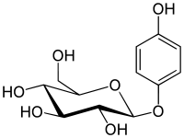
Chemical constituents:
  A phenolic glycoside arbutin
  Also contains
    methyl arbutin
    Quercetin
    Ursone
    Quinones
    tannins (6-10%) and
    terpenoids
Uses:
  Diuretic
  Astringent
  As an infusion in urethritis and cystitis.

Slide 94
5. Cyanogenetic glycosides
Cyanogenesis is the ability of certain living organisms, plants in particular, to produce hydrocyanic acid (HCN, prussic acid) on hydrolysis.
Cyanogenesis in plants is a chemical defense mechanism against organism damaging or feeding on plant tissues and lead to release of HCN gas, which is toxic.
They are distributed in over 2000 plant species belonging to 110 families.
  Examples such as Wild Cherry Bark, Almond

Slide 95
These compounds, in presence of enzymes such as β-glucosidase, lose their sugar portion to form a cyanohydrin which, in the presence of water and hydroxynitrile lyase, can undergo hydrolysis to give benzaldehyde and the highly toxic hydrogen cyanide (HCN).
The sugar portion of the molecule may be a monosaccharide or a disaccharide such as gentiobiose or vicianose. If a disaccharide, enzymes present in the plant may bring about hydrolysis in two stages, as in the case of amygdalin.
Cyanogenic glycosides are not toxic by themselves

Slide 96
Most cyanogenetic glycosides are biosynthetically derived from the amino acids
  valine, leucine, isoleucine, tyrosine or phenylalanine or nicotinic acid.
Cyanogenetic glycosides are easy to detect with a strip of filter paper impregnated with reagents able to give a colour reaction with the hydrocyanic acid released upon crushing the plant material
  e.g., picric acid/sodium carbonate or benzidine/cupric acetate.

Slide 97
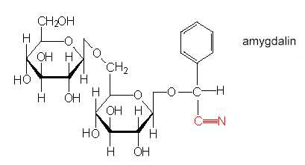
Examples:
Amygdalin in bitter almonds (Prunus amygdalus). It is biosynthetically derived from phenylalanine.
Linamarin in linseed (Linum usitatissimum). It is biosynthetically derived from valine.

Slide 98
Bitter almond
Synonyms: Amygdala amara
Biological source:
  Bitter almonds are dired ripe seeds of plants, Prunus amygdalus
Family: Rosaceae
Chemical constituents:
  Glycoside known as amygdalin(1 to3%)
  40-50% fixed oil, 20% proteins, 0.5% Volatile oil
  Enzyme emulsin
Uses:
  It is used as sedative due to hydrocyanic acid.
  Demulcent
  It is not used for flavouring foods.

Slide 99
Wild cherry bark
Synonyms: Virginian prune bark
Biological source:
  It is the dried bark of Prunus serotina
Family: Rosaceae
Chemical constituents:
  Glycoside called prunasin
  Prunasin on hydrolysis gives benzaldehyde, glucose and hydrocyanic acid.
  It also contains p-coumaric acid, benzoic acid, resin methyl aesculetin and trimethyl gallic acid.
Uses:
  It is used as expectorant and syrup is used as a flavouring agent.

Slide 100
6. Isothiocyanante glycosides
These are glycosides based on the following general formula:
The basic structure of glucosinolates comprises a glucose residue, a sulfate group found as potassium salt and a variable aglycone.
They are common in the family Brassicaceae.
Since glucosinolates are ionic compounds they can be separated on ion exchange resin.
When the tissues of glucosinolates-containing plants are bruised, the glucosinolates are hydrolyzed by a thioglucosidase commonly known as myrosinase (myrosin) which is always found in this type of plants

Slide 101
6. Isothiocyanate glycosides
  Allyl isothiocyanate is strong-smelling volatile compound responsible for the astringent odour and flavour of mustard.
  Uses of allyl isothiocyanate
    as condiment
  It is an irritant substance and therefore it is used as
    Counter irritant (rubefacient)
      Used in the form of plasters.
      If the plasters are applied too long, they can produce skin lesions.

Slide 102
Black mustard
Biological source:
  These are the dried ripe seeds of Brassica nigra or Brassica juncea
Family: Cruciferae
Macroscopy:
  Colour - Black or dark brown
  Odour - None, crushed seeds have pungent odour
  Taste - Bitter
  Shape - spherical

Slide 103
Chemical constituents:
  Black mustard seeds contain about 4% of isothiocyanate glycoside called sinigrin.
  Sinigrin on hydrolysis with water produce allyl isothipcyanate.
  Fixed oil 30%
  Proteins 20%
  Volatile oil 0.7 to 1.3%
Uses:
  It is a condiment
  It is emetic when used internally in higher doses
  Externally it is used as counter irritant and rubefacient in the form of poultice or plasters.
  All the activity of seed is due to sinigrin or consequent v.o

